Slide 1

Heart disease prediction
Presented By :- SOUJANYA PROKASH SINGHA
Enrollment ID :- ER924985092025781

Slide 2

Agenda
Project Overview
Business Problem
Dataset Overview
EDA
Data Preprocessing
Model Building
Model Evaluation and Model Selection
Model Saving
Building the Web Application
Web Application Demo
Conclusion
Future Improvements

Slide 3

Project Overview
This project aims to predict the likelihood of heart disease using machine learning techniques. By analyzing medical attributes such as age, cholesterol level, chest pain type, and blood pressure, the model identifies whether a patient is at risk. The final model is deployed using a Streamlit web application, allowing users to input their health details and receive instant predictions.

Slide 4

Business Problem
Heart disease is one of the leading causes of death worldwide. Early detection plays a crucial role in saving lives.
Traditional diagnosis methods :-
Take Time
Depend heavily on doctor experience
May lead to delayed decisions
Solution :-
A machine learning-based system that : -
Quickly predicts heart disease risk
Assists doctors in decision-making
Improves diagnosis accuracy
Reduces healthcare costs

Slide 5

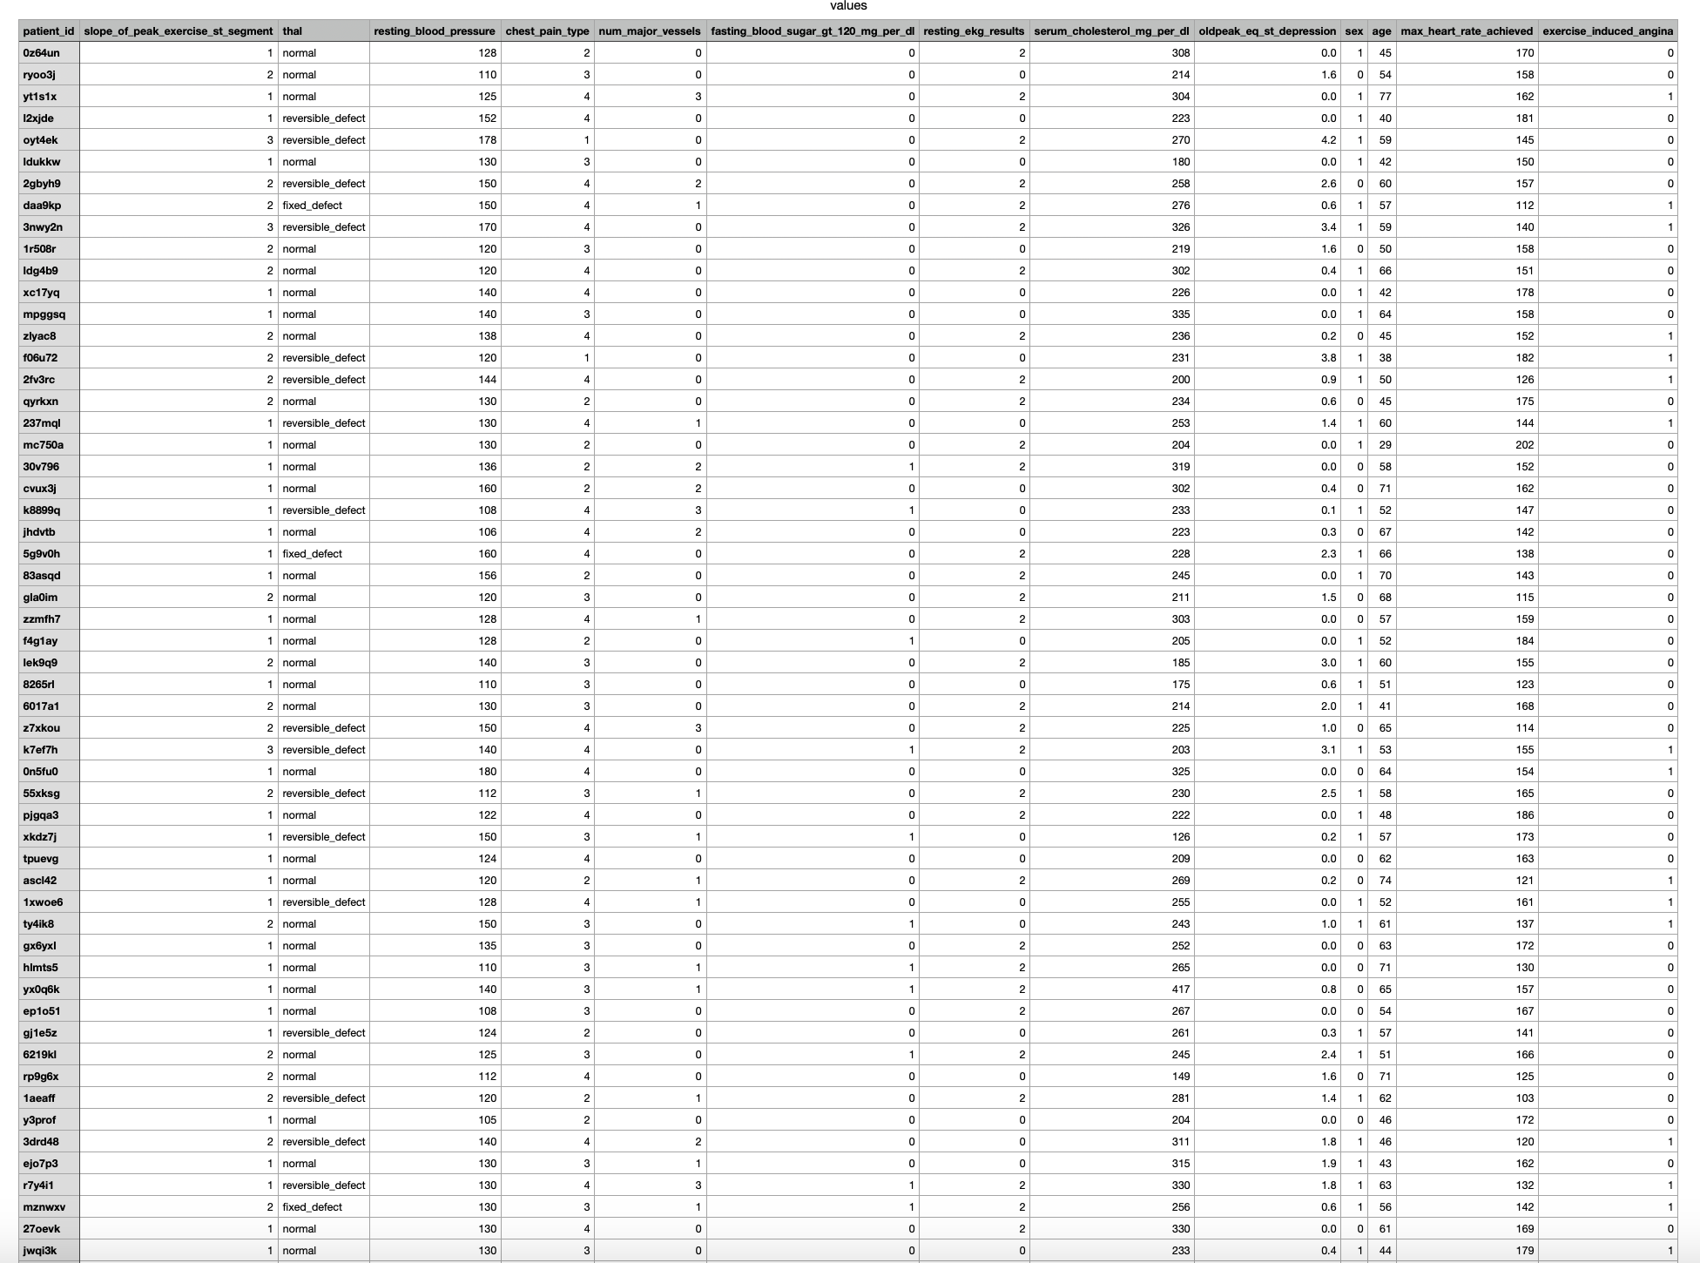
Dataset Overview
The dataset used in this project consists of structured medical records of patients, including both numerical and categorical features. Key attributes include age, sex, chest pain type, cholesterol level, resting blood pressure, fasting blood sugar, and maximum heart rate achieved. The dataset also includes information about exercise-induced angina and other clinical indicators. The target variable indicates whether a patient has heart disease, where 1 represents the presence of disease and 0 represents its absence. The dataset is well-suited for classification tasks and provides a solid foundation for building predictive models.

Slide 6

Exploratory data analysis
Exploratory Data Analysis was conducted to gain insights into the dataset and understand the relationships between different features. The analysis involved examining the distribution of numerical variables using histograms and boxplots, as well as analyzing categorical features through count plots. A correlation heatmap was generated to identify relationships between variables and their impact on the target. The analysis revealed that factors such as chest pain type, maximum heart rate, and cholesterol levels play a significant role in predicting heart disease. These insights helped guide further preprocessing and model development.

Slide 7
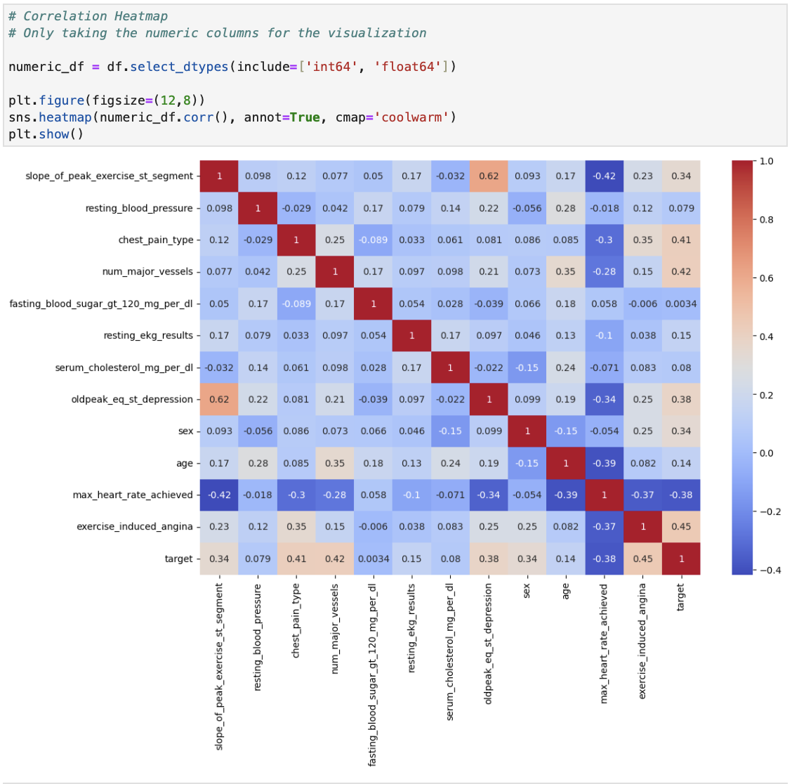
Correlation Heatmap

Slide 8
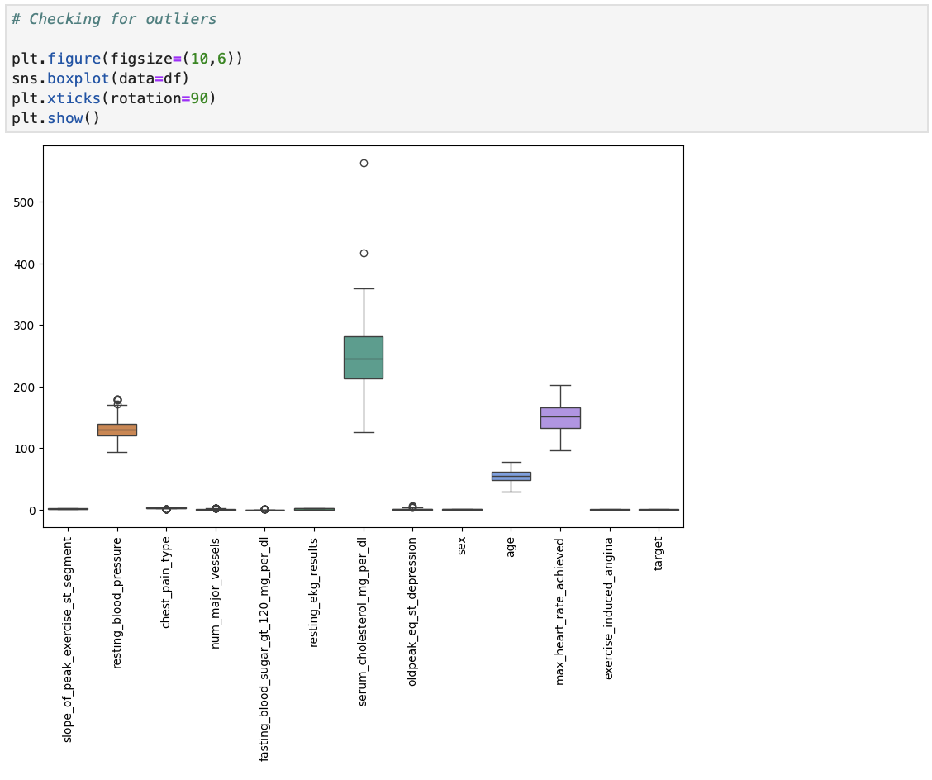
Outlier detection

Slide 9
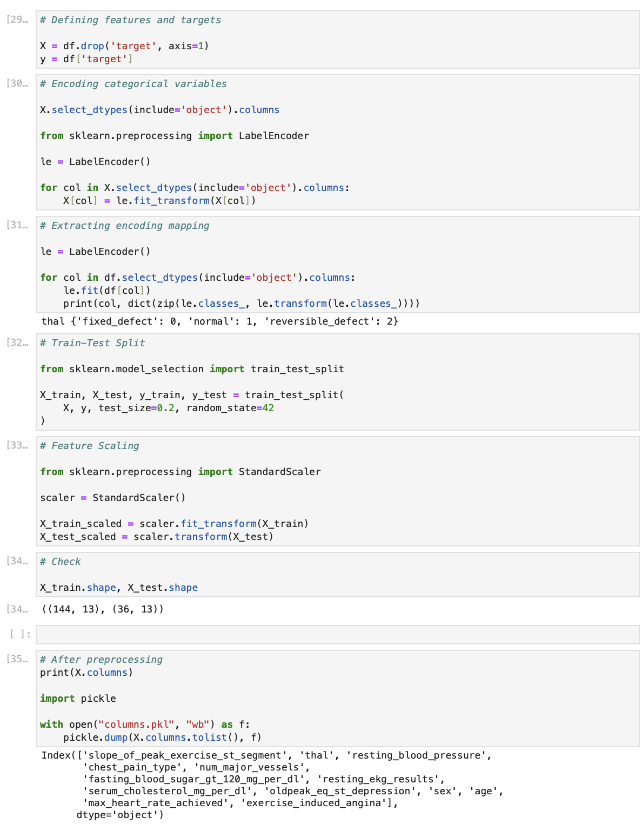
Data preprocessing
Data preprocessing was performed to clean and prepare the dataset for model training. The target variable was separated from the feature set, and the data was checked for missing or inconsistent values. Categorical variables were converted into numerical form using appropriate encoding techniques, while numerical features were standardized using scaling methods to ensure uniformity. The dataset was then split into training and testing sets to evaluate model performance effectively. This step ensured that the data was structured, clean, and ready for machine learning algorithms.

Slide 10
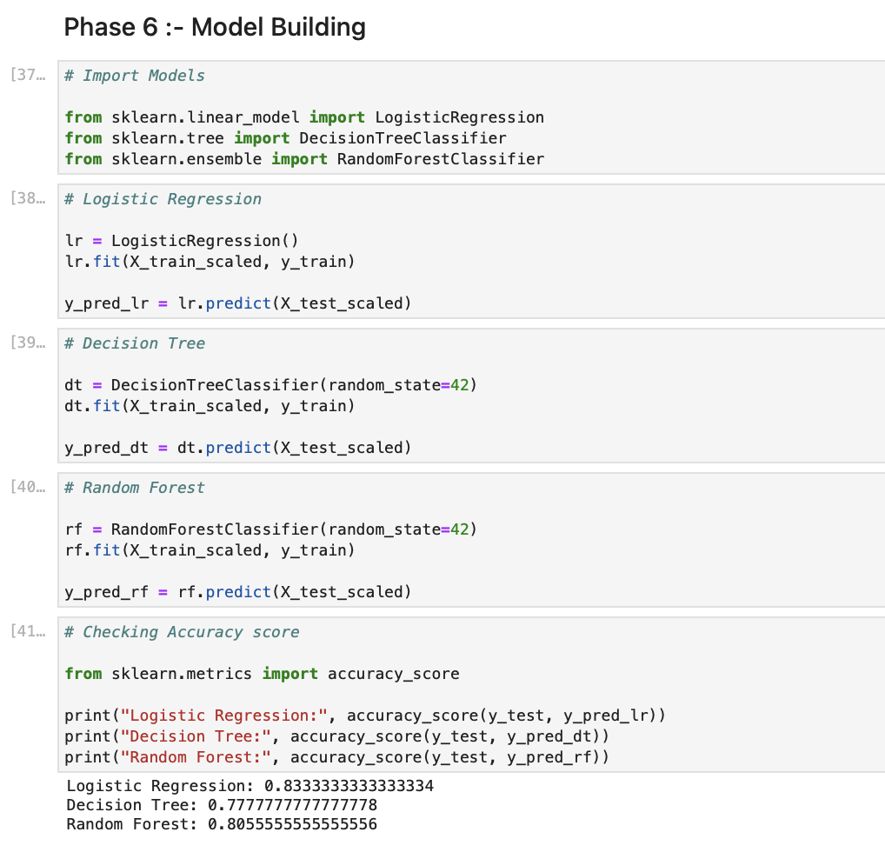
Model building
Multiple machine learning models were implemented to identify the most suitable algorithm for the prediction task. Models such as Logistic Regression, Decision Tree, and Random Forest were trained using the prepared dataset. A structured pipeline was created to combine preprocessing steps with model training, ensuring a smooth and efficient workflow. Each model was trained on the training data to learn patterns and relationships within the dataset, enabling accurate predictions.

Slide 11
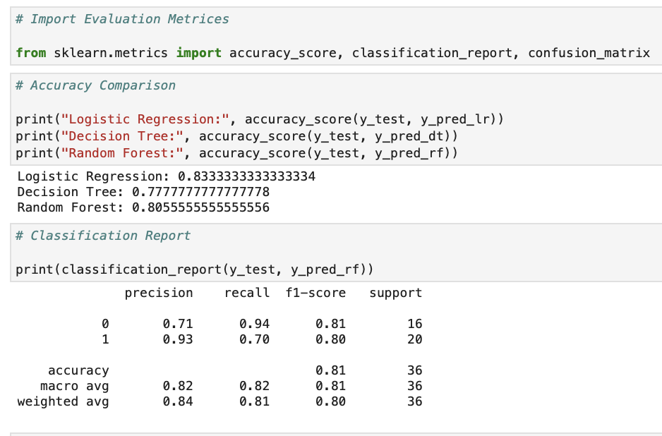
Model evaluation and model selection
The performance of each model was evaluated using classification metrics such as accuracy, precision, recall, and F1 score. A confusion matrix was also used to analyze the prediction results in detail. These evaluation techniques helped in understanding how well each model performed in identifying both positive and negative cases. Based on the comparison of these metrics, the best-performing model was selected for deployment. The selected model demonstrated a strong balance between accuracy and reliability.

Slide 12
Evaluation of models based on their metrics
Model | Precision | Recall | F-1 Score | Support
Linear Regression | 0.75 | 0.94 | 0.83 | 16
Decision Tree Classifier | 0.67 | 1.00 | 0.80 | 16
Random Forest Classifier | 0.71 | 0.94 | 0.81 | 16

Slide 13
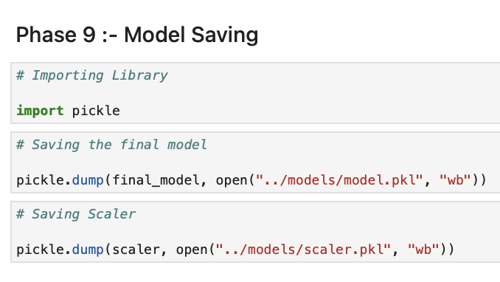
Model saving
After selecting the best-performing model, it was saved using serialization techniques to enable future use without retraining. Libraries such as Pickle or Joblib were used to store the trained model in a file format. Along with the model, preprocessing components such as the scaler were also saved to ensure consistency during prediction. This step allows the model to be easily loaded and integrated into applications for real-time predictions.

Slide 14

Building the web application
A web application was developed using Streamlit to make the machine learning model accessible to users. The application provides an intuitive interface where users can input their medical details. The backend integrates the trained model, processes the input data, and generates predictions instantly. This step transforms the machine learning model into a practical tool that can be used in real-world scenarios.

Slide 15

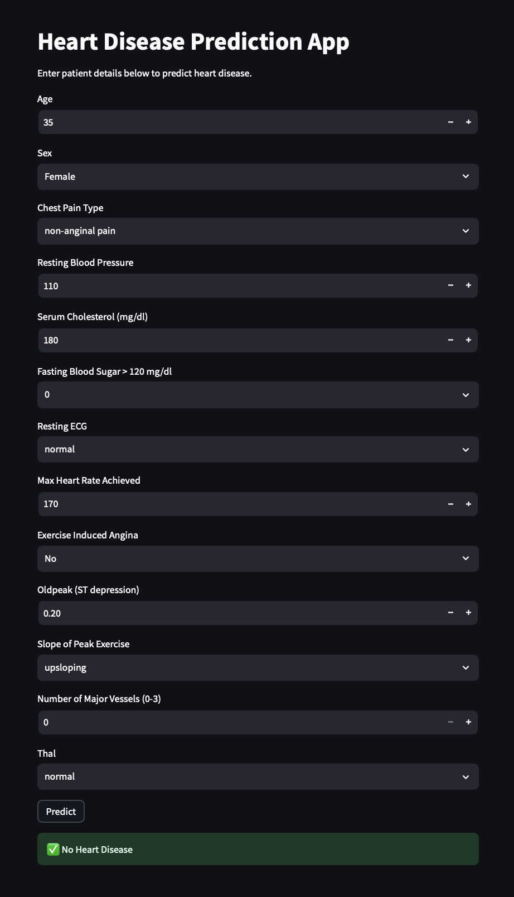
Web Application Demo

Slide 16

Conclusion
This project successfully demonstrates the development of an end-to-end machine learning solution for predicting heart disease. It includes all major stages such as data analysis, preprocessing, model building, evaluation, and deployment. The final model provides reliable predictions and has been integrated into a web application for practical use. The project highlights the potential of machine learning in improving healthcare decision-making and early disease detection.

Slide 17
Future improvements
Use a larger and more diverse real-world dataset to improve model generalization and reliability
Apply advanced machine learning algorithms such as Gradient Boosting, XGBoost, or Deep Learning models.
Perform hyperparameter tuning using techniques like GridSearchCV or RandomizedSearchCV to enhance performance.
Implement cross-validation to ensure robust and unbiased model evaluation.
Develop REST APIs using Flask or FastAPI for better integration with external systems.
Deploy the application on cloud platforms such as AWS, Azure, or Heroku for wider accessibility.
Incorporate additional features such as patient medical history and lifestyle habits for better predictions.
Improve the user interface and user experience to make the application more interactive and user-friendly.
Enable real-time data input and monitoring for continuous prediction updates.
Add explainable AI techniques to provide transparency in model predictions.

Slide 18

Thank you
SOUJANYA PROKASH SINGHA
E ID :- ER924985092025781
Soujanyaprokashsingha@gmail.com

